Slide 1

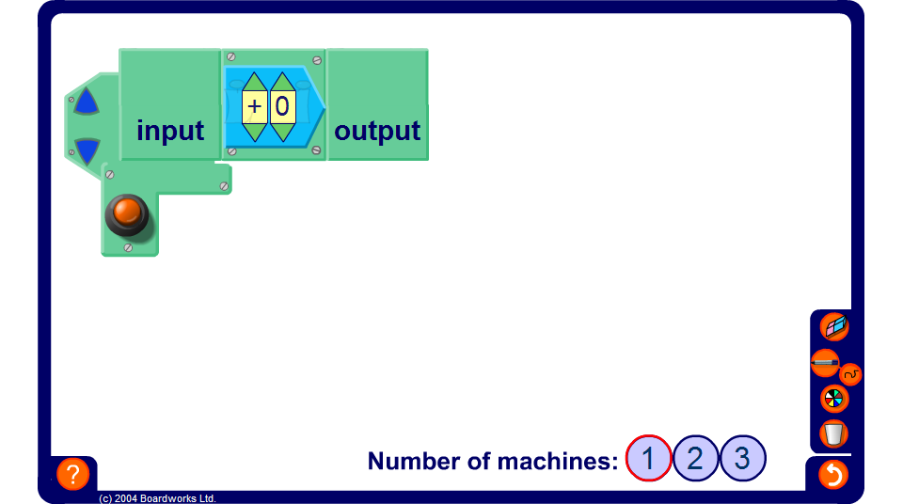


Finding functions given inputs and outputs
Notes:
Hide the functions then adjust them. By entering different inputs and recording the corresponding output, challenge pupils to find the function.
Show the operation in one of the machines and challenge pupils to find the other.
Notice that by entering the inputs in numerical order, starting with one, the outputs form a linear sequence. Remind pupils how to find the nth term of a linear sequence and use the rule for the nth term to find the function.
Another way to find the function would be to plot a graph of the points in the table and use the value of the gradient, m, and the y-intercept, c, to write the function in the form y = mx + c.
Point out that the same function can often be expressed in different ways. For example, 2(x – 2) is equivalent to 2x – 4. This means that ‘subtract 2 and multiply by 2’ is equivalent to ‘multiply by 2 and subtract 4’. Also ^{x + 6}/₃ is equivalent to ^{x}/₃ + 2. This means that ‘add 6 and divide by 3’ is equivalent to ‘divide by 3 and add 2’.
Link:
A4 Sequences – finding the nth term.

